Slide 1



THE PRINTERS HOUSE
Imprinting Excellence Worldwide Since 1946

Slide 2


Slide 3

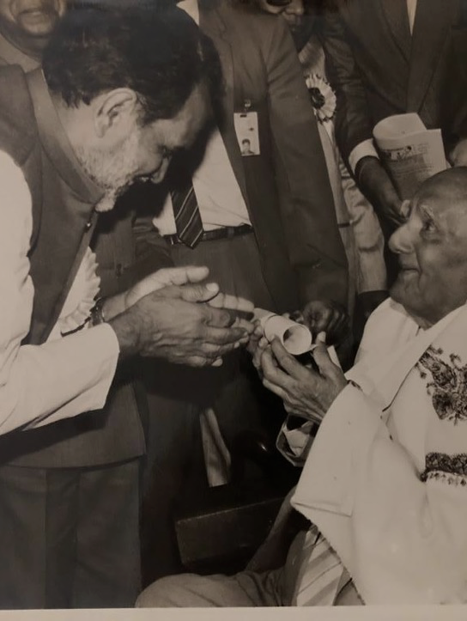
An Introduction: Our history
Sri K.D. Kohli receiving
the Kohinoor Ratna
The Printer’s House (TPH) Orient group is a diversified group of companies founded in 1946 that is an industry leader in the manufacturing and supply of a host of engineered products from India. A renowned and trusted name globally when it comes to quality manufacturing.
The Year was 1946. K.D. Kohli, a freedom fighter and newspaperman, started The Printers House (TPH) Orient group. Since then, TPH has carved a formidable reputation as a quality conscious technology driven manufacturer of a number of products. Tph’s adherence to global standards has enabled to export its products to more than 60 countries worldwide.
All our products are produced at factories in a 20 acre campus in Delhi NCR. Tph takes pride in being a company of Indian origin, started by an enterprising freedom fighter turned Newspaperman Mr. K.D. Kohli. The TPH Orient group is now a diversified group of companies and a market leader in printing machinery, packaging machinery , printing consumables , engineering services for Defence and aerospace, and solar energy.
However, it is in our humble origins we take solace and hope to continue to grow whilst supplying a product that can match any global standard.

Slide 4



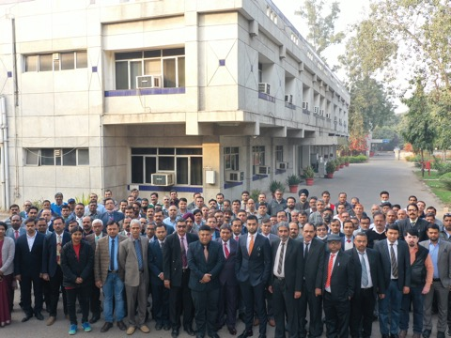
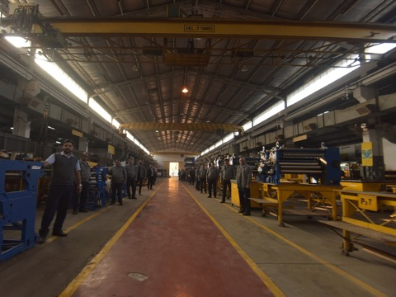
The TPH Family
TPH boasts an employee pool filled with skilled engineers & professionals.
TPH has 10 branch offices in major Indian cities and over 30 agents worldwide
The TPH family also extends to its loyal and crucial vendor partners , some of whom have grown with us for over 60 years.

Slide 5

The Global Presence
With exports to over 60 countries , TPH boasts a huge export portfolio which exemplifies our commitment to deliver high quality and high precision products with world class quality.

Slide 6
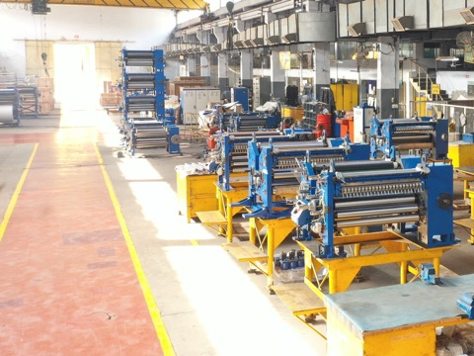

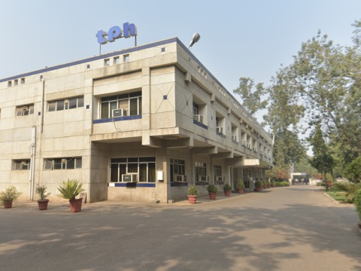
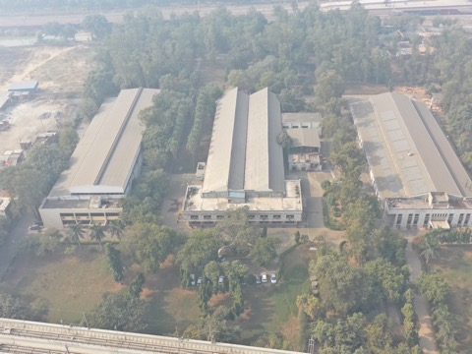
Manufacturing facilities
The TPH Orient group manufacturing campus spans 20 acres in area with lush green landscape
The campus houses various manufacturing units including a CNC workshop fitted with state of the art CNC’s for mechanical engineering purposes. Additionally our numerous testing and quality control equipment and pool of engineers allows us to provide world class products globally.
Our campus has facilities for products such as printing chemicals, offset printing machines, flexo printing machines, folder gluers , die cutters, high efficiency solar modules, printing plates, printing blankets, defense and aerospace engineered products etc.

Slide 7
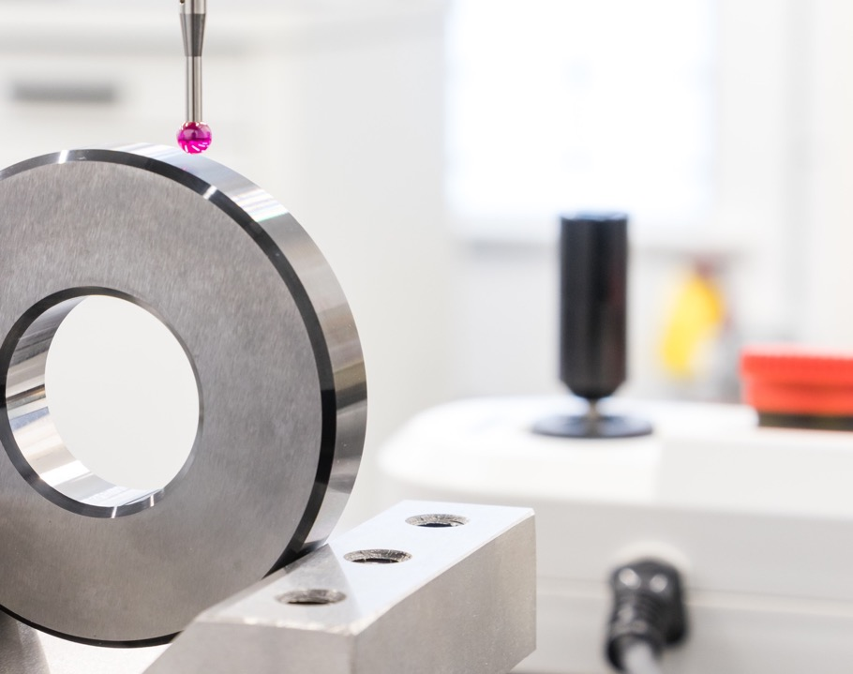
Quality Standards
TPH is an ISO 9001:2008 company
TPH also has certification
OHSAS 18001:2007
for health and safety Management System.
&
ISO 14001:2004
for Environmental Management System.
Over 3,000 quality checks are conducted for optimum performance

Slide 8
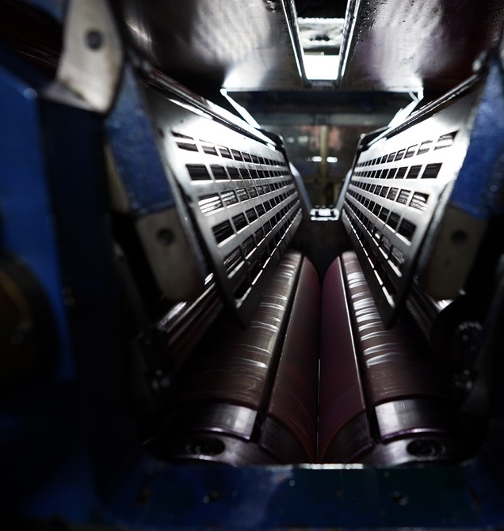
TPH Orient Web Offset

Slide 9
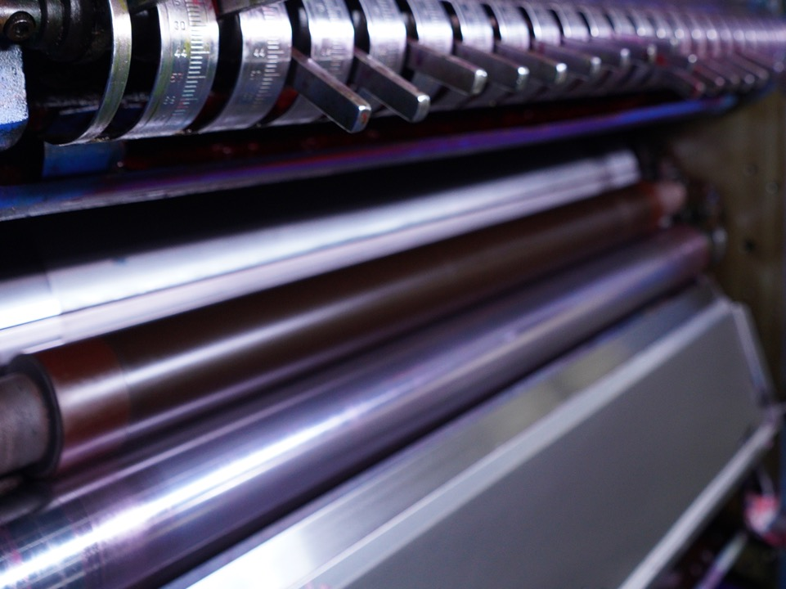
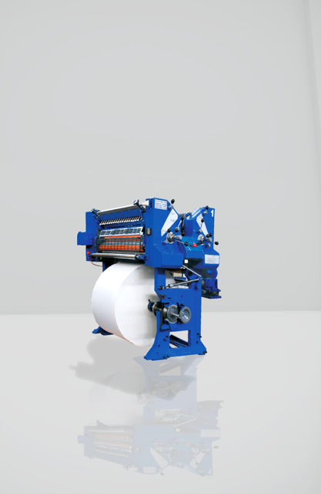
Orient Standard
Orient Standard is a single width single circumference web-offset press with a speed up-to 16000 cph or 16000 copies per hour for high quality newspaper printing , tabloid printing, book printing and semi-commercial products. The printing modules available for Orient Standard (16000 cph) are the Mono unit with Integral Reel stand and 3-colour satellite.

Slide 10
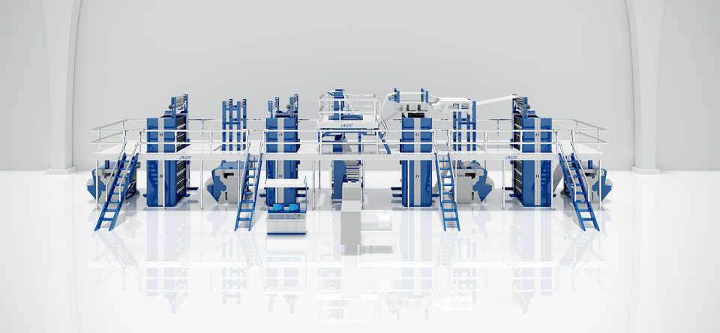
Orient Super
Orient Super is a single width Single circumference web-offset press with a speed up-to 30000 cph or 30000 copies per hour for high quality newspaper printing , tabloid printing, book printing and semi-commercial products. The printing modules available for Orient Super (30000 cph) are Mono Unit with Integral Reel stand, 3- Colour Satellite and 4 High Towers.

Slide 11
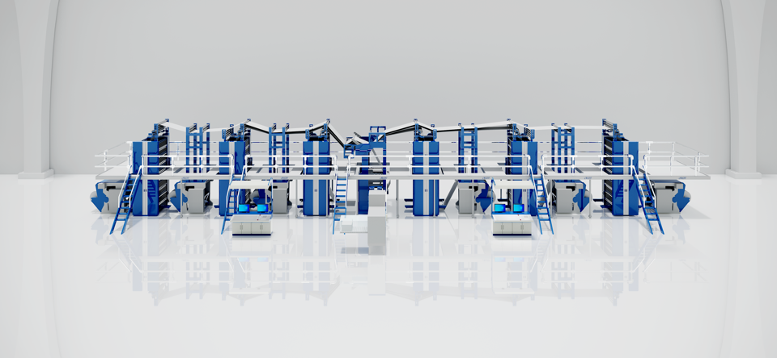
Orient X-Cel
Orient X-cel is a single width Single circumference web-offset press with a speed up-to 36000 cph or 36000 copies per hour for high quality newspaper printing , tabloid printing, book printing and semi-commercial products. The printing modules available for Orient X-cel (36000 cph) are Mono Unit with Integral Reel stand, 3- Colour Satellite , and 4 High Towers. Acclaimed as one of the finest web offset presses available worldwide, the Orient X-cel is truly an engineering marvel and a hallmark of quality and engineering excellence.

Slide 12
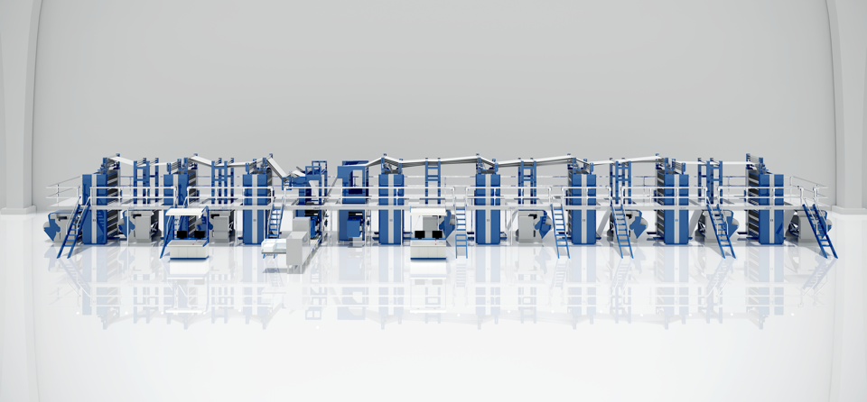
Orient X-Press
Orient X-press is a single width single circumference web-offset press with a speed up-to 50000 cph or 50000 copies per hour for high quality newspaper printing , tabloid printing, book printing and semi-commercial products. The printing modules available for Orient Xpress (50000 cph) are Mono unit with Automatic Reel Changers and 4 High towers.

Slide 13
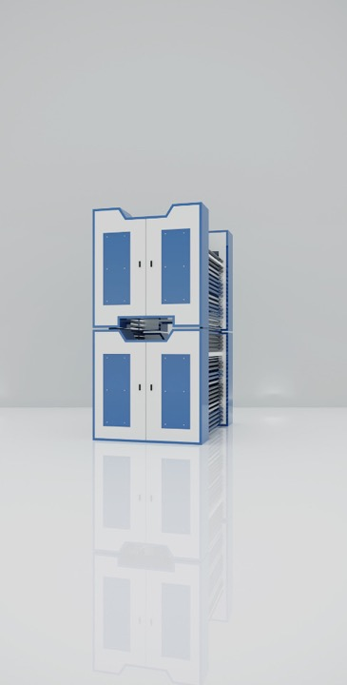
Orient XLC
Orient XLC is a single width Single circumference web-offset press with a speed up-to 30000 copies per hour for high quality newspaper printing, tabloid printing, book printing and commercial products.
This machine provides a compact alternative to traditional web-offset presses and is one of the most technologically advanced presses in the market today with an excellent ROI for our patrons.

Slide 14

With over 20,000 printing units supplied worldwide TPH enjoys strong relation-ships with some of the most distinguished and reputed commercial printers, publishers, and news houses in the world.

Slide 15



ORIENT Packaging

Slide 16
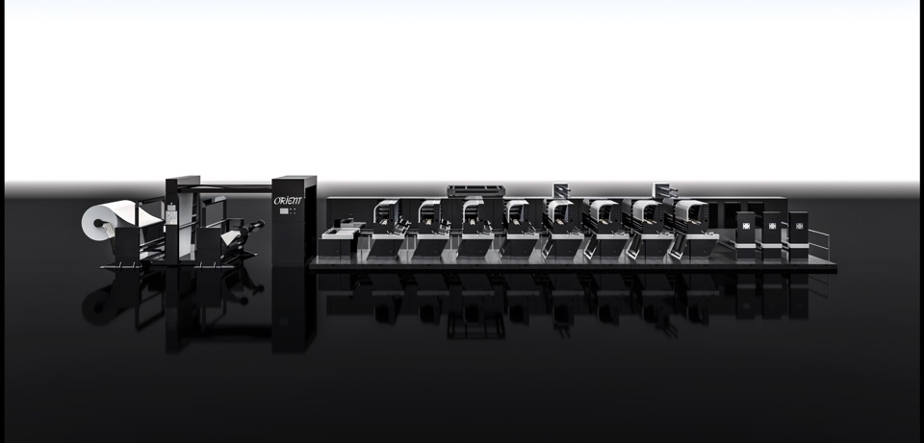
The Orient X-Press Flex

Slide 17
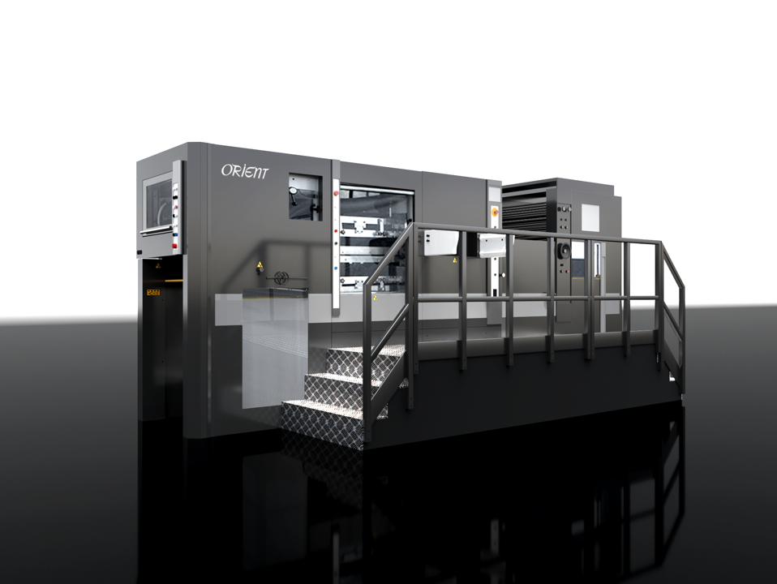
Orient X-Press Cut

Slide 18
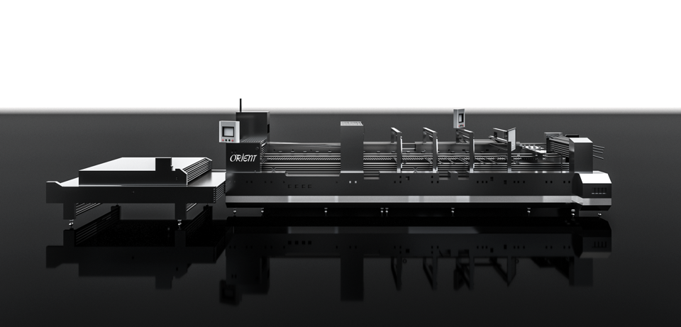
Orient X-Press Fold

Slide 19

Orient Inkjet Printing

Slide 20
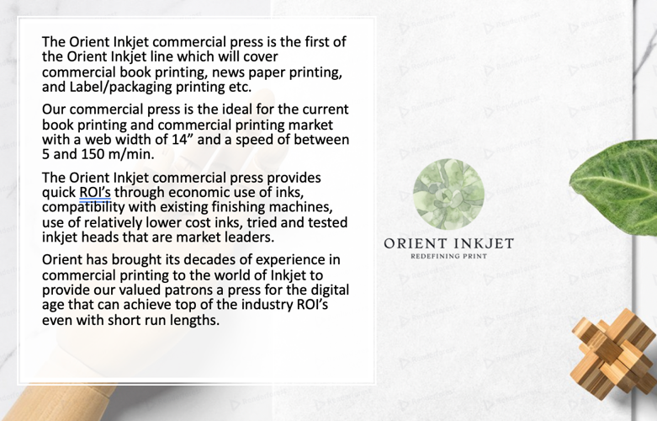

Slide 21
NexGen Orient Printing and Packaging consumables

Slide 22


Slide 23
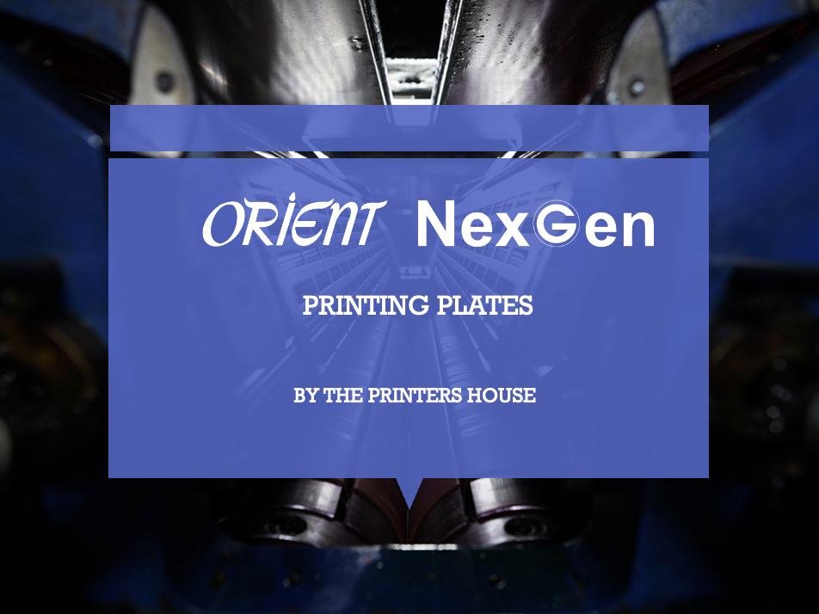

Slide 24
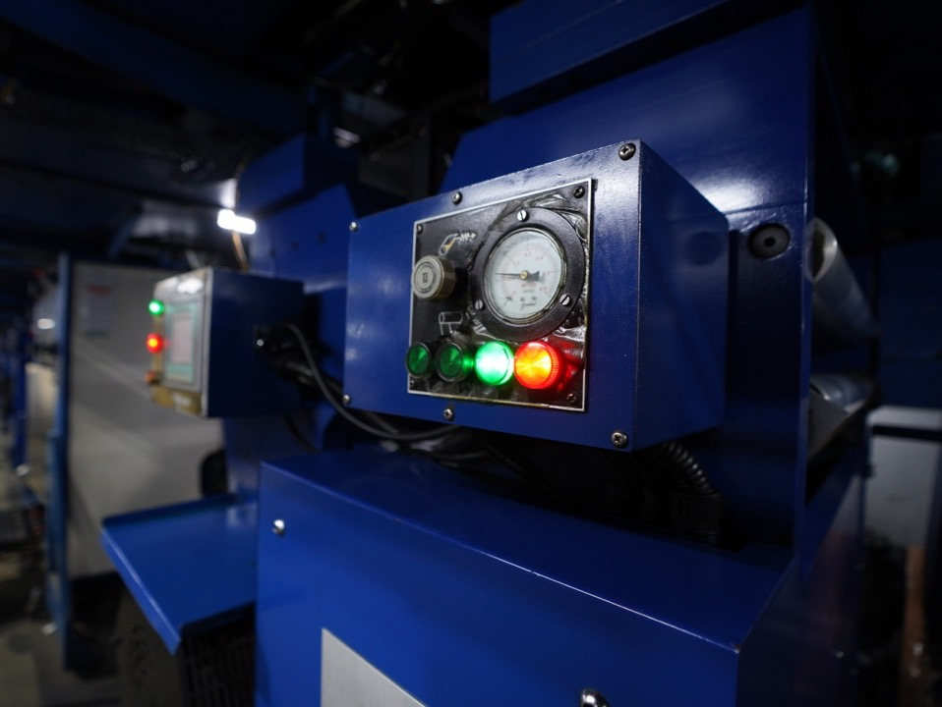
Orient Smart AMC
THE ORIENT ANNUAL MAINTENANCE CONTRACT AND SERVICING DEPARTMENT
PROVIDE WORLD CLASS SERVICING AND SUPPORT FOR ALL YOUR PRINTING NEEDS.
THE ORIENT AMC IS A CRUCIAL PART OF OUR PRINTING ECOSYSTEM AND ONE OF THE MOST IMPORTANT SERVICES OFFERRED BY THE COMPANY.

Slide 25

Orient Engineering division

Slide 26

Defense Manufacturing
Orient engineering boasts a tremendous capacity for heavy engineering in terms of space, CNC equipment, experienced engineers, and infrastructure.
Our wide range of products from housings to fully assembled products give us a great advantage and variety for our clients.

Slide 27

Aerospace
Orient engineering provides world class engineered products for the aerospace sector. The locality and robust supply chain in Faridabad gives a great advantage to Orient in these sectors and in tandem with out state of the art infrastructure we are able to provide highly technical solutions with extreme quality and precision.

Slide 28

Railways
With the immense space and technical knowledge available at Orient engineering, we are proud to be able to provide numerous solutions for the burgeoning railway sector in India.

Slide 29
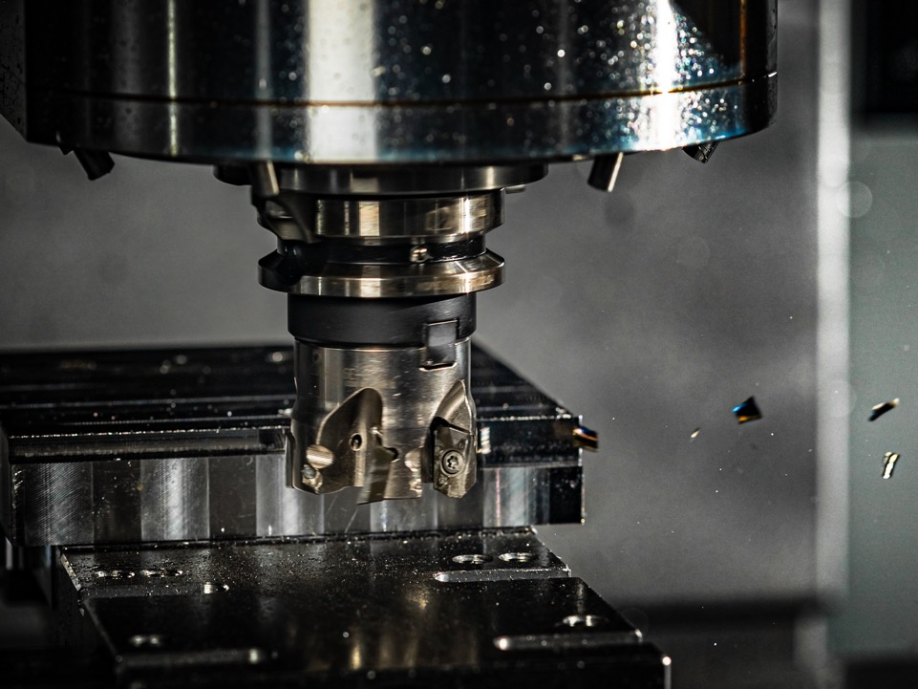
Heavy engineering and contract manufacturing
With our core competence in machining and assembly of engineering products with a strong design and R&D infrastructure, Orient engineering is one of the premium companies in the world for contract manufacturing and heavy engineering. The segments we cater to include oil and gas, automotive , railways, aerospace, defense, energy, molds and dies, construction machinery , and other subcontracting.
Our innovative and highly flexible design and R&D team is able to bring any design to life using our infrastructure with immense precision and quality.

Slide 30


ADM ORIENT SOLAR

Slide 31

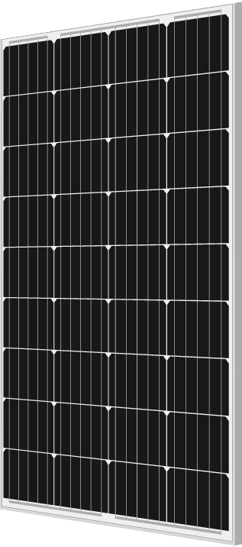
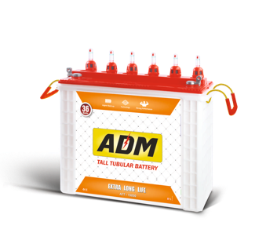
An excellence in manufacturing to build a more sustainable future
ADM Orient is a group company of the TPH Orient group of companies established in 1946. ADM Orient was founded on the principles of bringing the power of renewable energy to the average population at an affordable price through a strong belief in local manufacturing and expertise. With this goal in mind, ADM Orient boasts one of the largest fully automated panel manufacturing capacities and is one of the leading panel suppliers in the country , supplying both mono and polycrystalline PV modules with 5 or 10 BB cells. ADM Orient also acts as a principle and lead EPC solution provider for ensuring the completion of each Solar Plant from concept to the completion Solar Power Plant and provides smart city products for the general population. These products use solar energy to create a more sustainable and future ready society and are necessities in todays world to ensure a sustainable future for us as a populous.

Slide 32
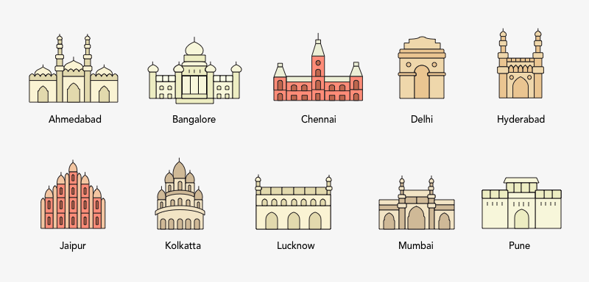
The TPH Family: Domestic Sales Network
Trivandrum
Kottayam
Orissa
With 10 offices in prime locations across India TPH proudly marks its presence across the country.

Slide 33


Slide 34
Our Contact Details
The Printers House (P) Ltd.
10, Scindia House,
Connaught Place, New Delhi, (India)
Tel: +91-11-23313071-73
Fax: +91-11-23310490
Email :tphindia@bol.net.in /tphho@tphorient.com
URL : www.tph.co.in

